Slide 1
Predicting Volatility in US Electricity Prices
Miles Franklin, David Harper,
Adam Goldstein, Himanshu Ghritalhre

Slide 2
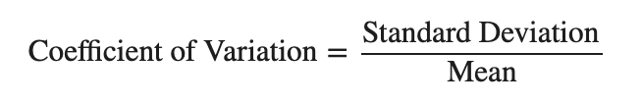
Project Overview
Target
The goal of this project is to produce a model predicting the price volatility of electricity for a given year. We measure the volatility using the Coefficient of Variation, to normalize the data and facilitate state to state comparisons.
Features
Distribution of fuel sources in a state (i.e. what percent of production is from coal, solar, etc.)
Whether or not the state is a net producer or consumer of electricity
Are the imports greater than the exports?
Is the state’s consumption of electricity greater than its production of electricity?
What effect do weather patterns have on price stability?
Do these effects felt impact renewable sources just
Can activity in the Futures Contract Market help predict price action?

Slide 3
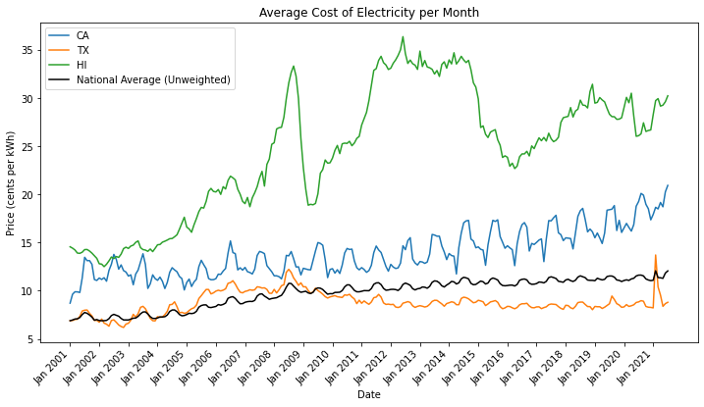
Understanding the Target Variable

Slide 4
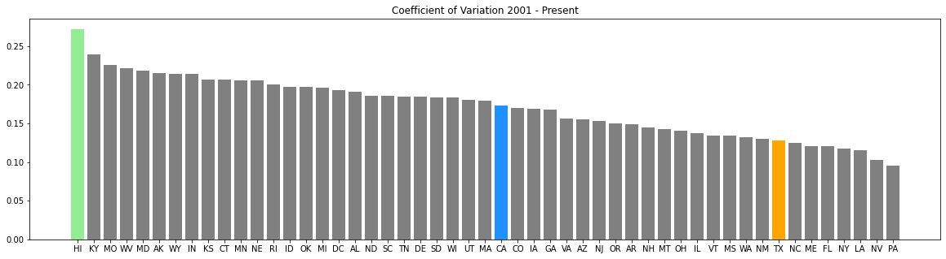
Understanding the Target Variable Con’t

Slide 5
Data Collection and EDA

Slide 6
Futures Data
Prices and Volume for Contracts
BZ - Brent Crude Oil
NG - Natural Gas
CL - Light Sweet Crude Oil
HO - Heating Oil
More will probably be added
Hypothesis: In times of energy price volatility, people may be buying or selling more futures contracts to lock in their price before big moves

Slide 7
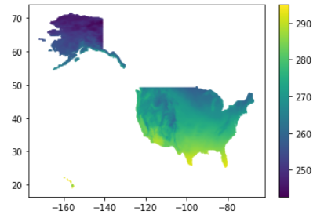
Weather Data
Monthly Average Temperature at 6m above ground
All of the United States gridded at 60km X 60km
Hypothesis: Temperature impacts price volatility because during hot and cold spells, residents are using a higher than average amount of electricity
Plan: Define a metric that determines how far above average summer temperatures were for per year by state. Define another metric that measure how below average winter temperatures were.
Possible Hurdles: Heat waves or cold spells that impact a particular region may not get detected when calculating metrics for an entire state

Slide 8
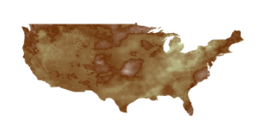
Weather Data (contd)
Palmer Drought Severity Index
All of the Lower United States gridded at 60km X 60km
Hypothesis: Droughts impact price volatility in regions that rely on hydroelectric power.
Plan: Calculate how many standard deviations above average a state is in terms of their drought index for all years of interest

Slide 9

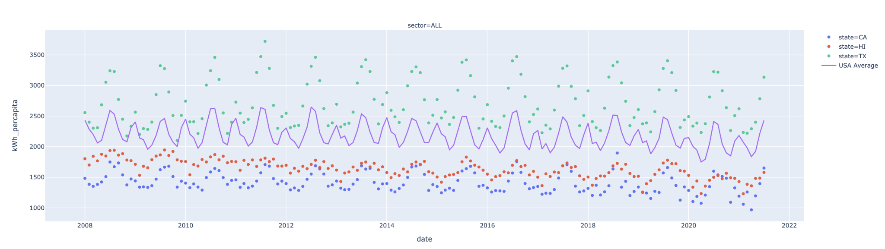
Monthly Energy Consumption

Slide 10
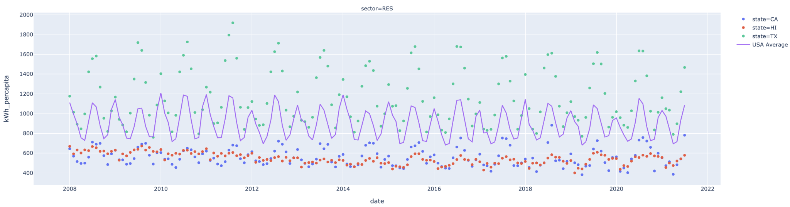
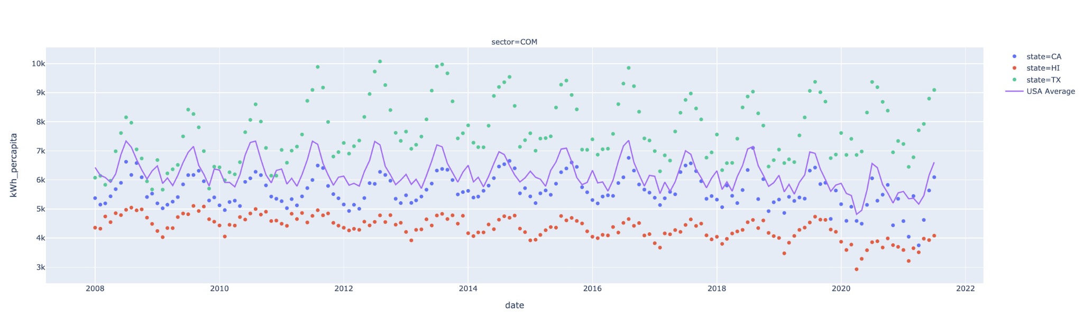
Monthly Energy Consumption

Slide 11
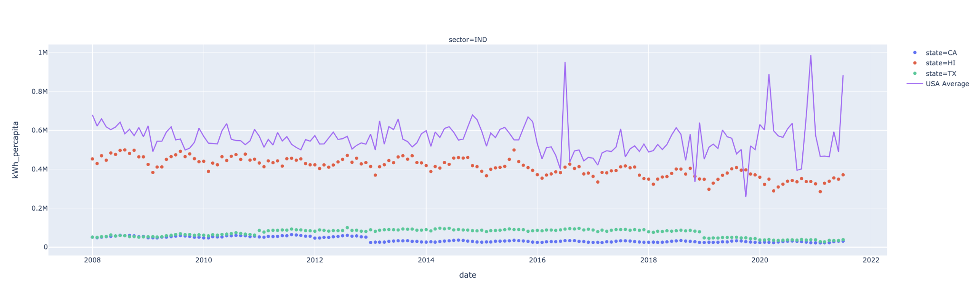
Monthly Energy Consumption

Slide 12
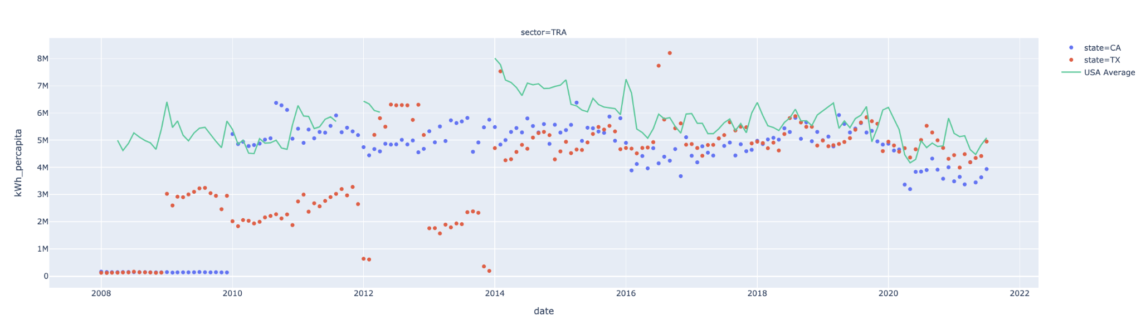
Monthly Energy Consumption

Slide 13
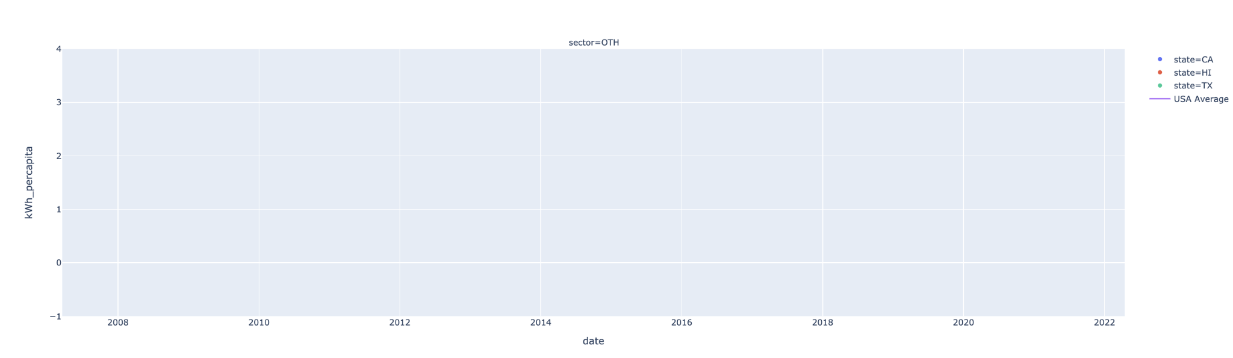
Monthly Energy Consumption

Slide 14
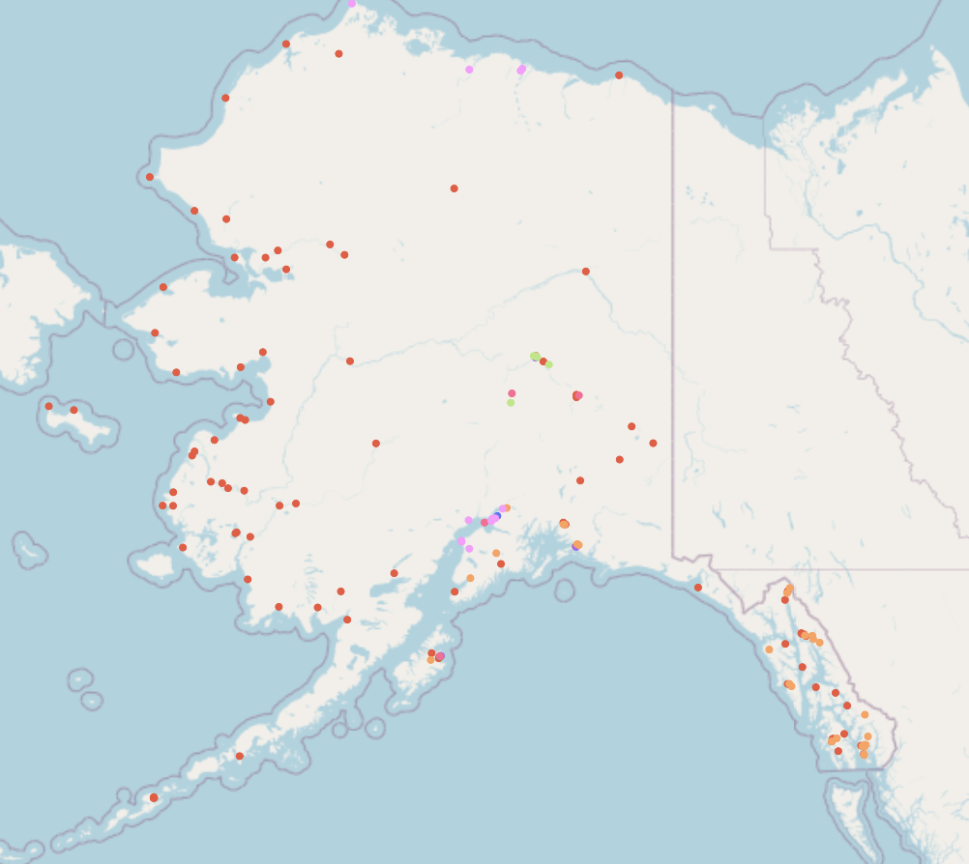

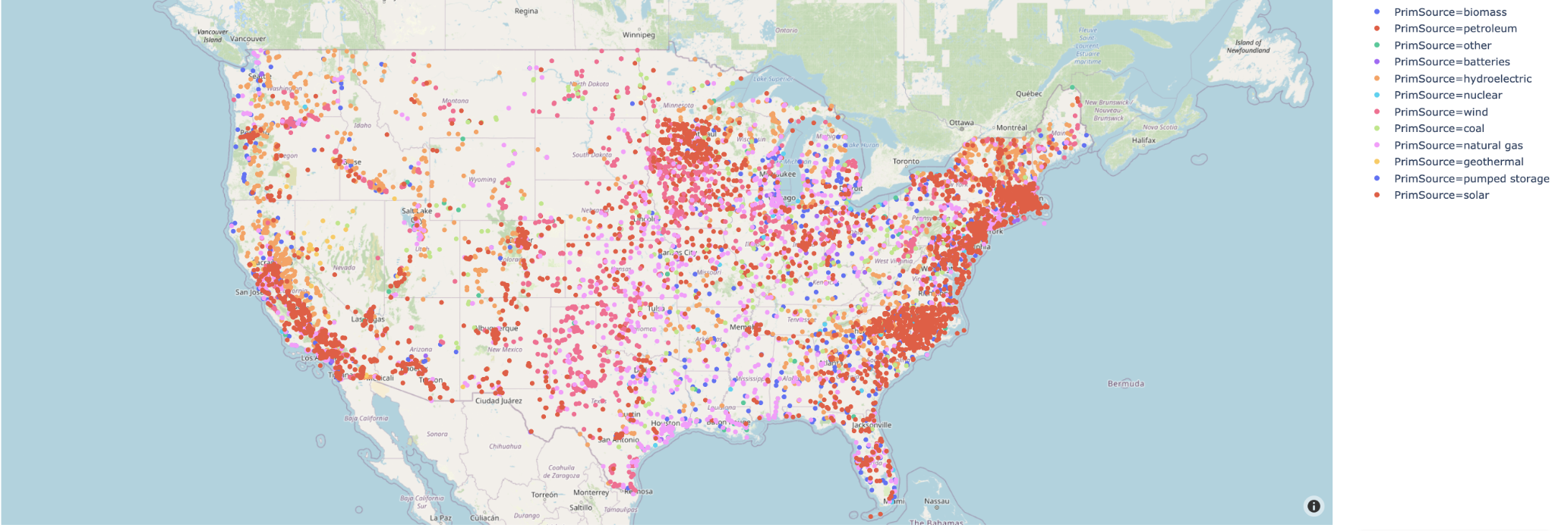
Plant Data

Slide 15
Similar Projects
Forecasting Electricity Price Time Series Data in Python using a VAR Model
http://dannychua.github.io/Electricity-Price-Predictor/
http://www.energyonline.com/reports/files/lcg_volatility.pdf

Slide 16
Next Steps
Additional data
Look into transportation sector (TRA) for why there are gaps in the monthly consumption data
Per Capita Calculation - Add United States population to compare with electric accounts
Emissions allowance market
Modeling
Combine data sources into one table of features to begin modeling
Start with regression models and simplify into classification models if needed
Evaluate what features are the strongest for our model

